Slide 1
Guideline on Blood Borne Virus Infections

Slide 2
Introduction
The recommendations in these guidelines include measures related to the prevention of transmission from, and the management and treatment of healthcare worker (HCW) with hepatitis B virus (HBV), hepatitis C virus (HCV) and/or human immunodeficiency virus (HIV).
There is a very low, but real, risk of transmission from a HCW with a bloodborne virues (BBV) to a patient, despite best practice infection control practices.
There are certain types of procedures, known as exposure prone procedures (EPPs), where it is possible that injury to the HCW could result in the worker’s blood coming into contact with the patient’s open tissues. Therefore, there is an increased risk of BBV transmission from either the HCW or the patient during EPPs.

Slide 3
Outline
Objective of the guideline
Risk of BBV transmission per exposure in healthcare settings
General Measures to prevent occupation transmission of BBV
Exposure prone procedures (EPPs)
The responsibilities of HCW
Procedures to be adopted by a HCW with suspected or confirmed BBV Infection
The responsibilities of treating physician
The responsibilities of FTC Committee
HCW with BBV not performing EPPs
HCW living with Hepatitis B infection
HCW living with Hepatitis C infection
HCW living with Human Immunodeficiency Virus infection
Confidentiality concerning the HCW living with BBV

Slide 4
1. Objectives of the guideline
1. Reduce the risk of medical practitioner to patient transmission of BBV.
2. Promote voluntary testing and self-declaration of BBV infection amongst HCWs.
3. Retain medical practitioner in the workforce and reduce adverse social and
professional impact on HCWs living with BBV.
4. Decrease the need for patient notification exercises.

Slide 5
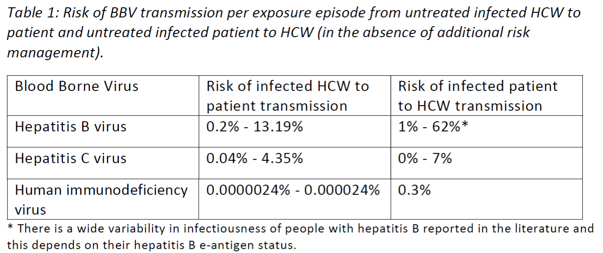
2. Risk of BBV transmission per exposure in healthcare settings

Slide 6
3. General measures to prevent occupational transmission of BBV
• avoid contact with blood or body fluids
• take all necessary precautions to prevent puncture wounds, cuts and abrasions in the presence of blood and body
fluids
• avoid use of, or exposure to, sharps when possible, and discard sharps directly into the sharps container immediately
after use
• protect all breaks in exposed skin by means of waterproof dressings and or gloves
• protect the eyes and mouth by goggles or safety spectacles and a mask when splashing is a possibility
• avoid contamination of the person or clothing by use of waterproof protective clothing, plastic apron
• wear rubber boots or plastic disposable overshoes when the floor or ground is likely to be contaminated
• apply good, basic hygiene practices, including hand-washing, before and after glove use, and to avoid hand-to-mouth
or eye contact
• control surface contamination by blood and body fluids by containment and appropriate decontamination procedures
• dispose of all contaminated waste safely and refer to relevant guidance

Slide 7
4. Exposure prone procedures (EPPs)
Exposure prone procedures (EPPs) are procedures where there is a risk of injury to the HCW resulting in exposure of the patient’s open tissues to the blood of the HCW.
These procedures include those where the HCW’s hands (whether gloved or not) may be in contact with sharp instruments, needle tips or sharp tissues (spicules of bone or teeth) inside a patient’s open body cavity, wound or confined anatomical space where the hands or fingertips may not be completely visible at all times.

Slide 8
Discipline | Examples
Cardiothoracic surgery | generally all cardiothoracic procedures
Dentistry | maxillofacial surgery and oral surgical procedures, including the extraction of teeth (but excluding extraction of highly mobile or exfoliating teeth), periodontal surgical procedures, endodontic surgical procedures, implant surgical procedures.
Gynaecological surgery | perineal surgery, trans-vaginal surgery, and open abdominal gynaecological surgery
Neurosurgery | exposure to sharp bone fragments e.g. trauma and some spinal surgery.
Obstetric or midwifery procedures | procedures: including caesarean birth, instrumental birth, infiltration of the perineum with local anaesthetic, episiotomy, repair of an episiotomy or perineal/vaginal tear, application of a fetal scalp electrode, and fetal blood sampling.
These lists are intended as guidance and do not cover all eventualities and must be interpreted with caution. The relevant specialist body can provide more detailed information about what procedures are considered exposure prone in their specialties

Slide 9
Discipline | Examples
Open surgical procedures | open abdominal or thoracic general surgery, open abdominal or thoracic vascular surgery and open urological procedures
Orthopaedic procedures | cutting or fixation of bones or the distant transfer of tissues from a second site (such as in a thumb reconstruction), open surgical procedures where there is the possibility of bone fragments and/or bone spicules, mechanical drilling, or the procedure involves deep tunneling using sharp instruments.
Otolaryngology, head and neck surgery | in particular bony facial reconstructive surgery (elective or after trauma)
Plastic surgery | extensive cosmetic procedures that involve bony reconstruction or free tissue transfer involving bone or in the thorax.
Trauma | open head injuries, facial and jaw fracture reductions, extensive soft tissue trauma, rectal examination in the presence of suspected pelvic fracture, deep suturing to arrest haemorrhage and internal cardiac massage
These lists are intended as guidance and do not cover all eventualities and must be interpreted with caution. The relevant specialist body can provide more detailed information about what procedures are considered exposure prone in their specialties

Slide 10
Examples of procedures which are not EPPs
Venesection
Inserting intravenous lines or central lines
Percutaneous cardiac procedures (eg, angiography and catheterization)
Routine vaginal or rectal examination
Administering injections
General wound dressing and minor surface suturing
Incision of external abscesses
Bronchoscopy
Insertion and maintenance of epidural and spinal anaesthesia

Slide 11
Examples of procedures that are generally considered to be non-EPP but have the potential to escalate to open or trauma procedures
Minimally invasive procedures: including laparoscopy, endovascular procedures, thoracoscopic procedures, Natural Orifice Transluminal Endoscopic Surgery (NOTES), cystoscopic procedures, arthroscopic procedures, and robotic surgery.
Trauma/emergency situations: there is the risk in trauma/emergency situations that a previously non-EPP may escalate (and quickly) into an EPP. This context must be considered for paramedics, emergency department staff, and HCWs who work in rural or remote areas.

Slide 12
5. The responsibilities of HCW
All HCWs are expected to protect the health and safety of their patients.
HCWs must also be tested for BBVs after the occurrence of any potential occupational and non-occupational exposure incident.
All HCWs, including student HCWs, should be vaccinated against HBV prior to the commencement of employment
All registered HCWs who perform EPPs must confirm when applying for renewal of registration that they comply with these Guidelines

Slide 13
Responsibilities of the HCW with a BBV who perform EPP
to be compliant with their prescribed treatment and have ongoing viral load monitoring at the appointed time
to seek advice to release monitoring information to the treating doctor, and jurisdictional health department
to release health monitoring information (including viral load and relevant clinical information), to a designated person in their workplace in the event of a potential exposure incident to the public health
must not perform EPPs if there is a change in health condition may affect their fitness to practice or impair their health
all HCWs with unknown status who undertake EPPs should be tested for BBVs at least once every three years.

Slide 14
6. Procedures to be adopted by a HCW with suspected or confirmed BBV Infection
Take leave from his professional duties immediately by informing in confidence his supervisor.
Seek confidential consultation with a Physician.
Submit a latest medical report to MMC and attend the review with the FTP (Fitness to Practice) MMC.
Consent for the recommendations of the FTP Committee to be submitted to the President of the Council in confidence.
Comply with the decisions of the President of the Malaysian Medical Council with regards employment and restrictions to practice.
Immediately report all incidents of exposure of the HCW with BBV’s blood or bodily fluid to the patient’s open tissues to the designated occupational physician in their health facility.

Slide 15
7. Responsibilities of the HCW’s treating physician
identify any conflict of interest (whether actual or perceived) towards the HCW and be willing to report any breaches in compliance with these guidelines.
ensure the HCW has scheduled appointments of appropriate frequency for the level of monitoring they require
actively follow up missed HCW appointments to ensure timely rescheduling
report concerns regarding HCW compliance with professional standards to the relevant area of the jurisdictional health department in a timely manner
report concerns regarding actual or potential exposures constituting a public health risk to the relevant area of the jurisdictional health department

Slide 16
Responsibilities of the HCW’s treating physician
(cont)
6. The treating doctor may inform the relevant area of the jurisdictional health
department when a HCW is no longer cleared to perform EPPs.
does not attend their appointments or fails to be tested within the prescribed
timeframe without prior notification and adequate justification to their doctor,
refuses to have their viral load tested, or
continues to perform EPPs when excluded by these Guidelines.

Slide 17
8. Responsibilities of the Fitness to Practice (FTP) Committee
A registered HCW with a BBV infection will be referred to the FTP Committee to be appointed by the President of Council.
The FTP Committee shall be composed of the responsible physician treating the practitioner, and other members as appointed by the President of MMC.
The duties of the FTP Committee will be to:
a. Obtain a confidential briefing/report on the practitioner by the Responsible Physician.
b. Suggest on the most appropriate action to be taken with regards job placement,
restriction of duties, monitoring, further treatment, etc.
c. Review the application for practitioner who applies to perform EPPs together with the
experts from the specialty involved.
d. Submit the suggestions and recommendations to the President of Council for further action

Slide 18
9. HCWs with BBV (Hepatitis B, Hepatitis C, HIV) not performing EPPs
If HCW do not involve in exposure prone exposure, the possibility of provider-to-patient transmission is considered extremely low.
HCW with BBV and who do not perform EPPs may continue to provide clinical care to patients.
It is in the best interest of the HCW own health to remain under regular medical care

Slide 19
10. HCW with HBV infection
All HCW and student HCW should be vaccinated against HBV prior to commencement of employment if they have no documented evidence of preexisting immunity (from resolved infection or prior vaccination).
All HCW should be assessed for immunity post-vaccination
A HBV-infected health care worker should, in general, be on antiviral with effective viral suppression regardless of whether he or she is HBeAg positive or negative if he or she intends to perform EPPs.

Slide 20
Initial health clearance for HCW with HBV who wish to perform EPPs
HBV DNA viral load undetectable or very low (<50IU/ml)
Either from natural suppression or on continuous antiviral therapy
Be subject to plasma viral load monitoring every 12 - 24 weeks
Be under joint supervision of a responsible physician and occupational health unit of employing organisation (if self-employed must be under joint supervision of a responsible physician and MMC)
Agree to inform MMC if there is any change in work scope

Slide 21
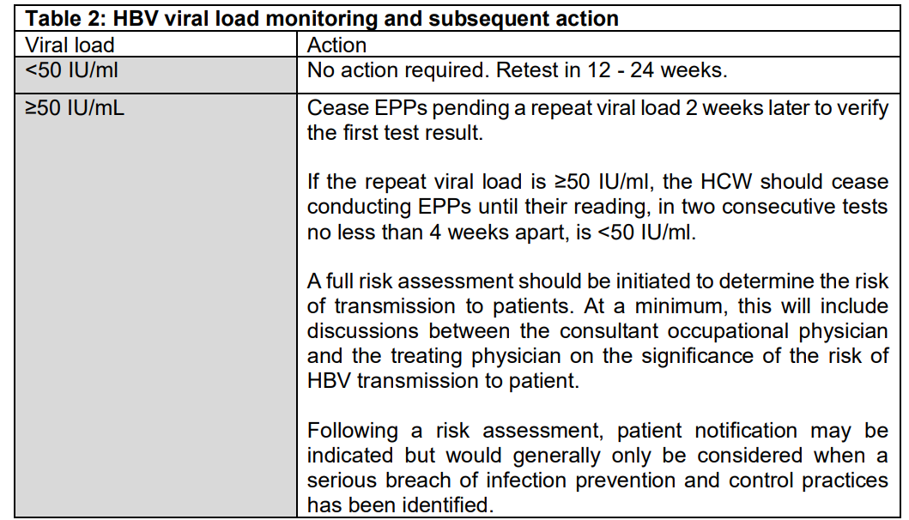

Slide 22
11. HCW with HCV infection
The management of anti-HCV antibody positive HCW starts with confirmation of HCV infection; i.e both anti-HCV antibody and HCV RNA are detectable.
The WHO 2016 guidelines on management of HCV prioritized the treatment of HCV infected HCW because successful treatment minimizes the risk of transmission of HCV to patients.
The response to DAA is assessed by sustained virological response (SVR) defined as undetectable HCV RNA at 12 or 24 weeks after the completion of a course of DAA.
A SVR corresponds to a cure of the HCV infection, with a very low chance of late relapse.

Slide 23
Initial health clearance for HCW with Hep C who wish to perform EPPs
1. if anti-HCV positive, must be repeatedly HCV RNA negative
Or
2. If HCV RNA positive, must be treated and be HCV RNA negative for at least 6 months after cessation of treatment (ie achieve sustained virological response at 24 weeks post treatment, SVR24)
3. Additional test for HCV RNA at 3 months after SVR24. However, in the presence of ongoing risk factors that could not be completely removed, annual HCV RNA is required.

Slide 24
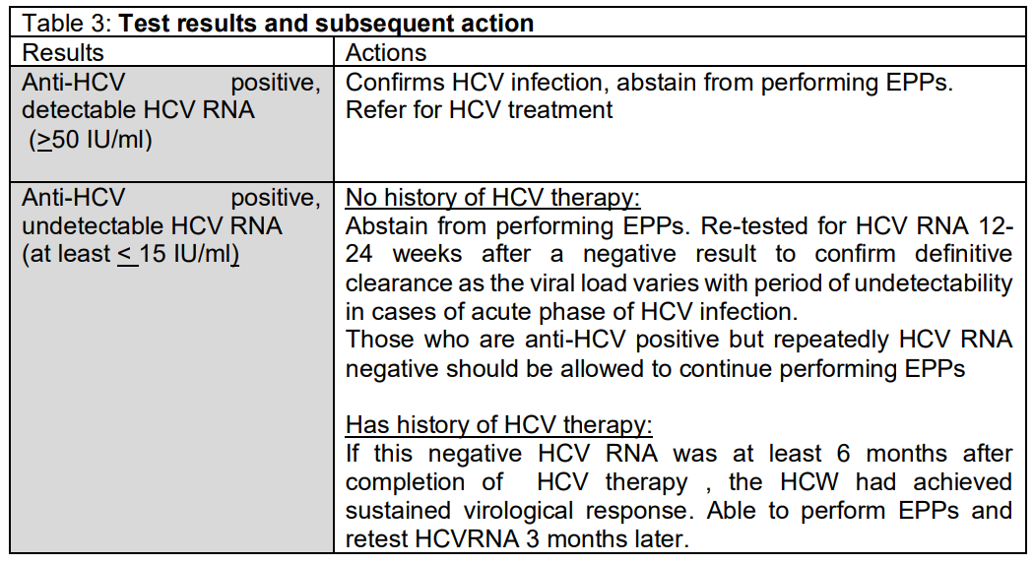

Slide 25
12. HCW with HIV infection
Current treatment guidelines recommend lifelong treatment with cART to all regardless of clinical stage or CD4 count.
Therefore all HCWs with HIV should be started on cART as soon as they were diagnosed.
Aim of treatment is to maintain their HIV viral load less than the detectable range (<50IU/ml)

Slide 26
Initial health clearance for HCW with HIV who wish to perform EPPs
Being on combination cART with a viral load below 200 copies/mL, measured on two occasions no less than 3 months apart,
and
3. be subject to plasma viral load monitoring every 12 -24 weeks, as decided by the FTP Committee
4. be under joint supervision of a responsible physician and occupational health unit of employing organisation (if self-employed must be under joint supervision of a responsible physician and MMC)
5. agree to inform MMC if there is any change in work scope

Slide 27
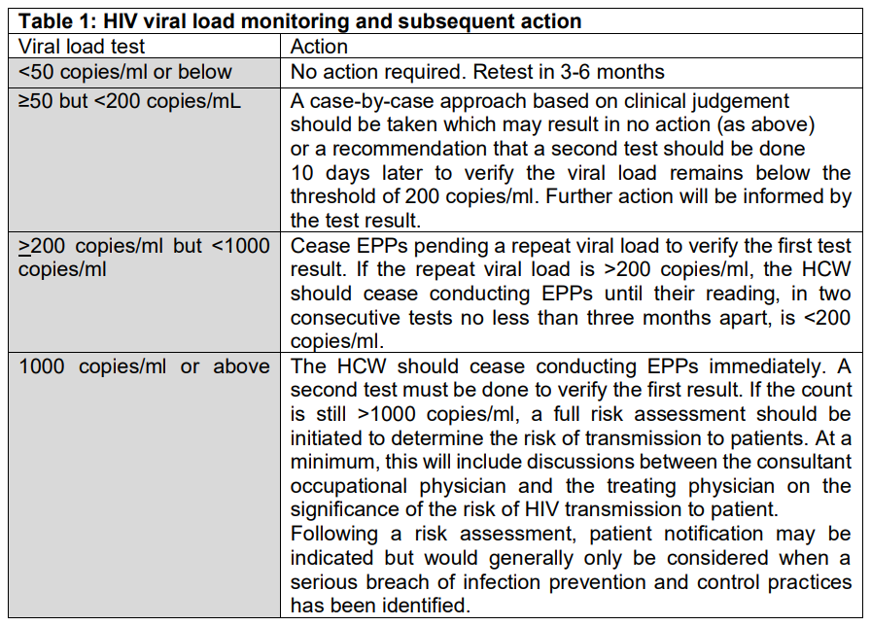

Slide 28
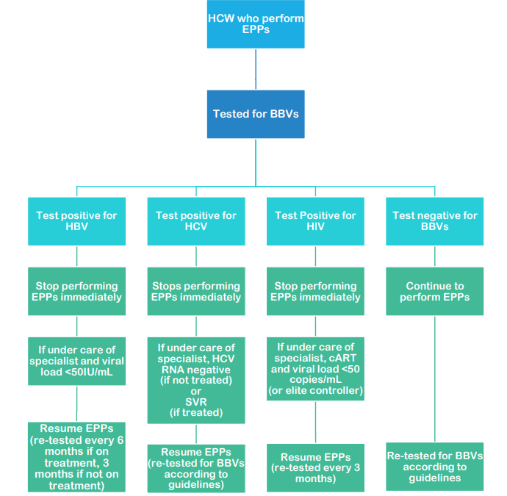

Slide 29
13. Confidentiality concerning the HCW living with BBV
It is extremely important that a BBV infected HCW, particularly with HIV infection, receives the same rights of confidentiality as any patient seeking or receiving medical care.
There is a general duty to preserve the confidentiality of medical information and records.
Any unauthorized disclosure about the BBV (particularly HIV) status of an employee or patient constitutes a breach of confidence and may lead to disciplinary action or legal proceedings.
However, the identity of infected individuals may be disclosed without their consent in exceptional circumstances where it is considered necessary for the purpose of treatment, or prevention of spread of infection

Slide 30
Reference
Guideline on blood borne viral infections Malaysian Medical Council 2020
Australian National Guidelines for the management of healthcare workers living with blood borne viruses and healthcare workers who perform wxposure prone procedures at risk of exposure to blood borne viruses 2019
Integrated guidance on health clearance of healthcare workers and the management of healthcare workers living with bloodborne viruses (hepatitis B, hepatitis C and HIV) UK Advisory Panel for Healthcare Workers Living with Bloodborne Viruses (UKAP) 2021

